Slide 1
SharePoint UI Advancement
Notes:
In this module you will cover the new SharePoint user interface. An important topic since the UI is the primary surface end-users interact with to get things done. It is also prime real-estate for extensibility since we all need our customizations to surface somewhere. You can give a quick idea of the notion of fluency introduced with the 2007 Microsoft Office System, and how you will see in this model that the concept now also reaches the server.

Slide 2
Outline
Introducing the new User Experience
The SharePoint Fluent User Interface
Sites as Collections of Pages
Managing Data with SharePoint 2010
Notes:
There are four main topics in this module that you can introduce on this slide.
- The New UI: Mainly focuses on what difficulties people felt with SharePoint 2007. Introduces the Fluent UI in SharePoint and how the new UI will solve all difficulties.
- The SP Fluent UI: Talks about the ribbon, dialogs and other behaviors that give people a sense of Fluency, such as in-place editing.
- Pages: Talks about how sites really are collections of pages that display data and allowing easy editing. Users do not tend to think of a website as a collection if lists, which was prevailing in SharePoint 2007 and the source of many difficulties people had with this product.
- Data: Talks about what is new for lists, such as the XsltListViewWebPart and InfoPath integration

Slide 3
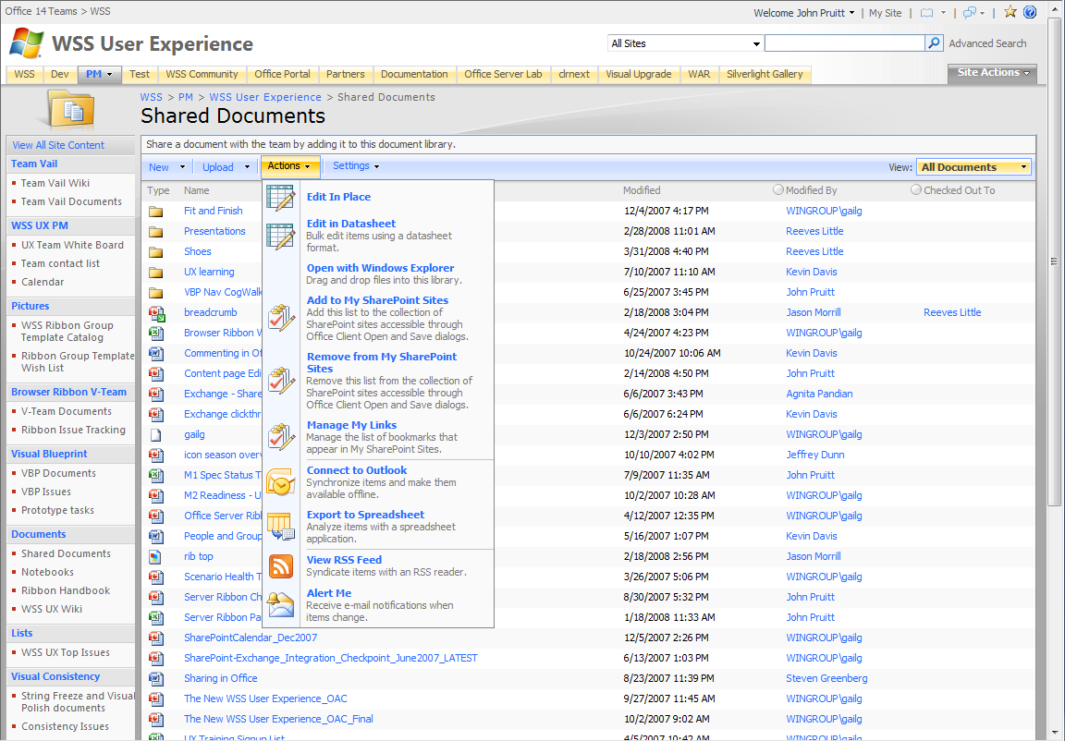
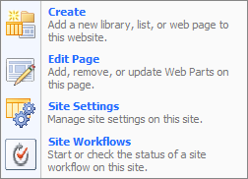
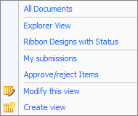
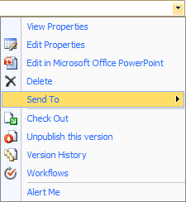

SharePoint 2007 Command Surfaces
Commands EVERYWHERE
Notes:
Talk about how there are many different surfaces to interact with in SharePoint 2007. These surfaces each have unique aspects and ways to interact, for instance, the ECB dropdown, Site Actions, List Actions might all contain items that operate on the list. It is not entirely clear what command is available in each place, and also, if the command is available outside of the direct list view when that list is placed as a Web Part on a page.

Slide 4
SharePoint 2007 Navigation
Page reloads and navigations
Microsoft Confidential
Notes:
Talk about what happens when users start to use these surfaces. Talk about how many commands will cause the entire page to reload or cause a navigation to occur. Reloads and navigations are a prime cause for end-users losing focus and getting lost in the product. IW productivity is hindered when they have a complex UI to deal with. The product should allow people to focus on what they intend to do, and should prevent people from needing to modify their normal working routines to work around product complexities.

Slide 5
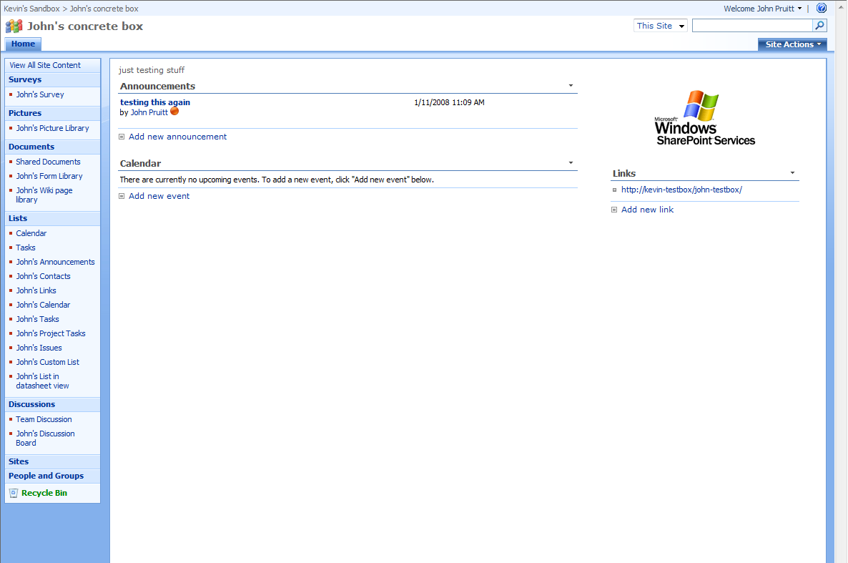
SharePoint 2007 Web Part Interaction
Web part interaction? …a choice of displaying one command or full toolbar which adds visual clutter
Microsoft Confidential
Notes:
An important aspect of SharePoint is its capability to create rich interactive dashboard pages using Web Parts. However, for authors of these Web Parts it is hard to show a rich interface for end-users to interact with. The toolbar is rather ugly, and a single command is rather limited. You can talk about how having more than one ListViewWebPart on this page adds to the clutter and does not allow the same level of interaction as when viewing each list separately.

Slide 6
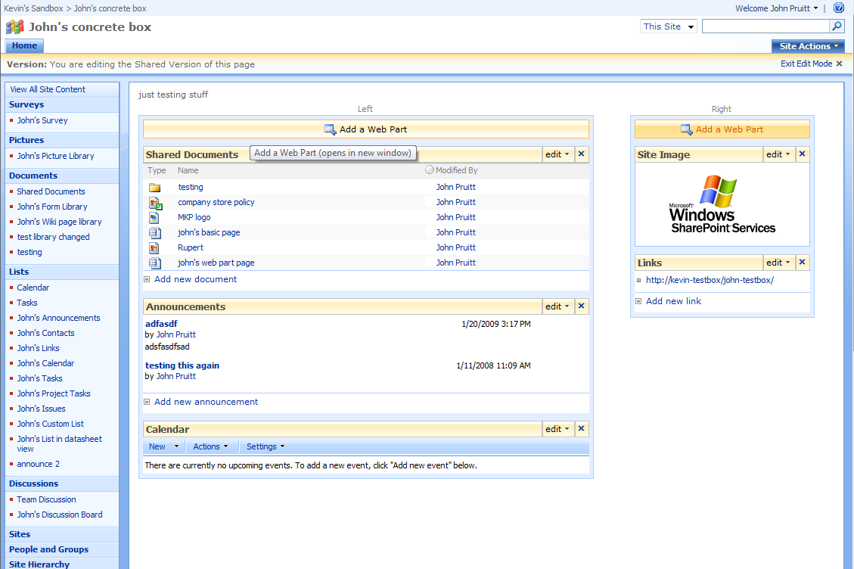
SharePoint 2007 Page Editing
Page Editing – difficult just to add text and your own images
Notes:
Now take a look at the process which people need to go through when wanting to create a basic page containing some formatted text and some data from a list or two.
They need a library to store their page. Shared Documents is used often in a Team site, but this library is named inappropriately)
They need to create a Web Part page and add the appropriate Web Parts
They need to interact with a Content Editor Web Part, which uses the toolpane to edit content. Not intuitive at all.
Adding any rich content like images requires a separate image upload (to?) and then difficult inclusion on a page (url based)

Slide 7
Feedback on SharePoint 2007
“SharePoint design is not intuitive and it is difficult to learn and use.”
“Lack of customization is due to difficulty, not lack of desire.”
“End users are not adequately trained on SharePoint. Many obtain little to no training.”
Notes:
Intermediary slide that you can quickly skim over or use as a display when you tell the attendees that Microsoft feels your pain.

Slide 8
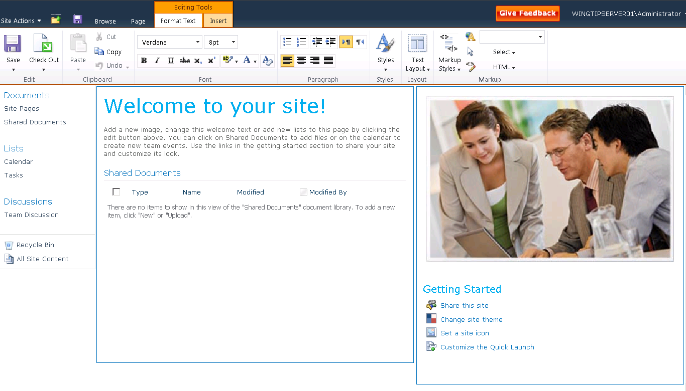
The SharePoint 2010 User Interface
Notes:
A handy screenshot that allows you to introduce some of the things we will talk about in the next few topics.
You can introduce fluency with the ribbon, dialogs and in-place editing.
You can introduce the concept of pages as prime content
You can introduce the new XsltListViewWebPart viewing technology.

Slide 9
Outline
Introducing the new User Experience
The SharePoint Fluent User Interface
Sites as Collections of Pages
Managing Data with SharePoint 2010

Slide 10
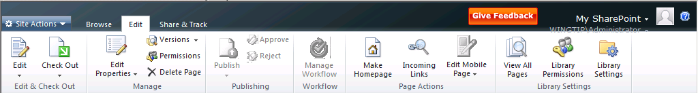
The Server Ribbon
Consistent
Streamlined
Familiar
Notes:
The prime real-estate of SharePoint 2007 has been consolidated into the Ribbon.
Consistency with the client ribbon in style, controls and sense of fluency (automatic resizing for instance)
Streamlined, AJAX enabled, only gets content that is shown
Familiar, it will be the place to interact with SharePoint for just about any task that end-users need to get done in the product.
Since this is a developer crowd, you can introduce the concept of using XML and JavaScript as a platform for extending the ribbon.

Slide 11

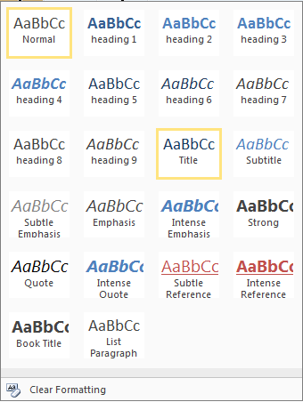


Server Ribbon Controls
Out
In-ribbon gallery control
Drop down grids are our answer
IN
Button
Split button menu
Static
Stated
Drop down & Flyout menus
Customizable
Hierarchical
Checkbox
Toggle Button
Label
Textbox
Combo box
Spinner
Table control
Color picker
Notes:
There are a large amount of controls that you can show on the Ribbon, including custom controls. For a large part there is parity between the client and the server ribbon, except for the in-ribbon gallery (the style picker in Word / Excel / PowerPoint). These controls create rich and familiar surfaces for end-users to interact with.

Slide 12
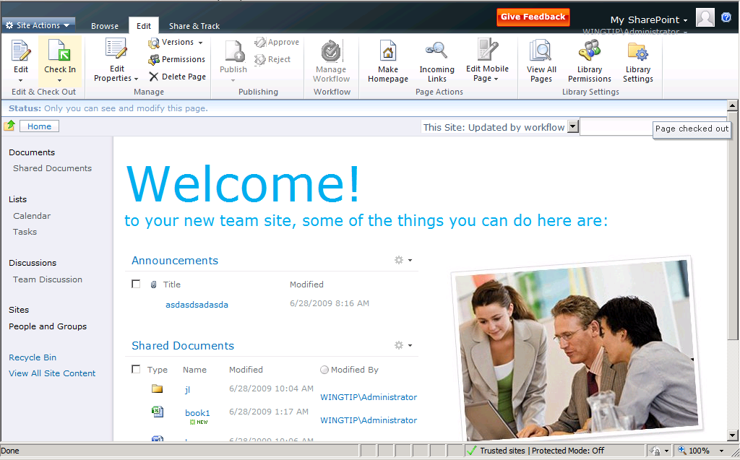
Status Bar and Notification Area
Notification
Status Bar
Notes:
The Status Bar and Notification Area are to prime places to show messages to the end-user. The status bar can be shown in a few fixed colors that indicate a positive or negative status. The Notification area is used for smaller messages. Of course both items can be accessed through code so you can show your own messages using SharePoint infrastructure.

Slide 13
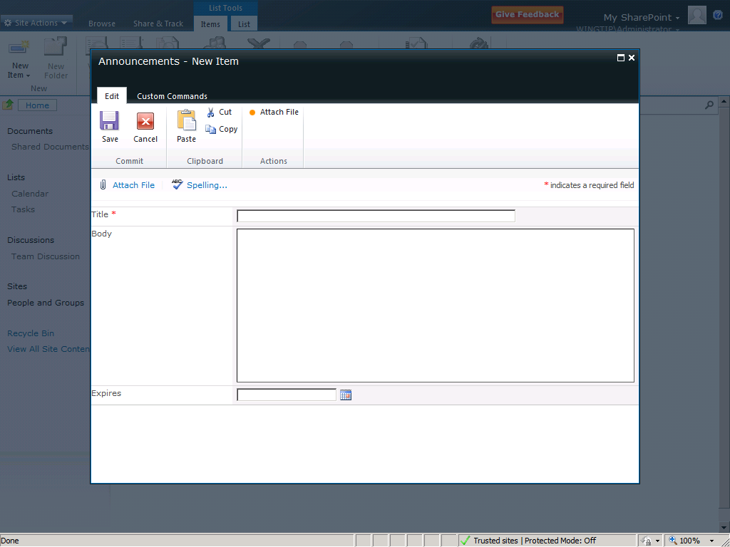
The Dialog Framework
Notes:
Next we move to richer interaction than just showing a message. SharePoint 2010 has a new framework for showing dialogs to the end-user. The dialogs allow people to work with some data without losing focus on the page they were working on to get things done. Closing the dialog will often cause AJAX based refreshes to give a sense of stateful-ness.
The dialog is of course extensible through JavaScript code. You can either show a separate page, or use a DOM element on the source page and show that. You can then determine when the dialog closes and what happens when it has closed.

Slide 14
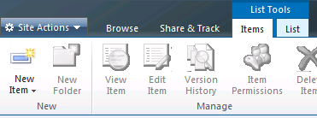



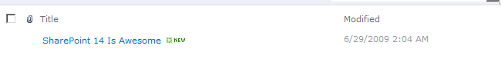
In-Place Editing
Popup dialog
AJAX refresh
Notes:
One of the primary scenarios that a dialog enables is in-place editing. The idea here is that when you add new content to a list, you do not need to navigate to a separate page to perform that task, you can use the ribbon to add a new item, fill in the dialog that appears and the page will refresh automatically. A second important feature is inline-editing. In this mode you can edit list data directly from within the list view, without showing a custom form page in a dialog. This is similar to the DataSheet view in SharePoint 2007 only making use of pure HTML.

Slide 15
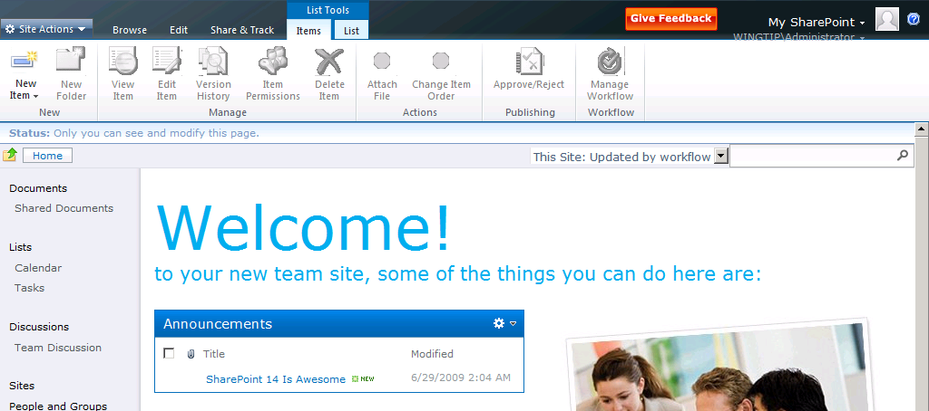
Multi-Level Targetting
No context switching. Edit content where you see it.
Notes:
The concept of multi-level targeting is that a ribbon shows content for multiple levels in SharePoint. You are within a site, so the site context applies. You might be on a page, so the page context applies too. On this page you might have selected a list view Web Part, which also add to the context of what the ribbon shows. There is no need to actually go to a list to work with it. You can just do that from anywhere you see the list data.

Slide 16
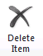
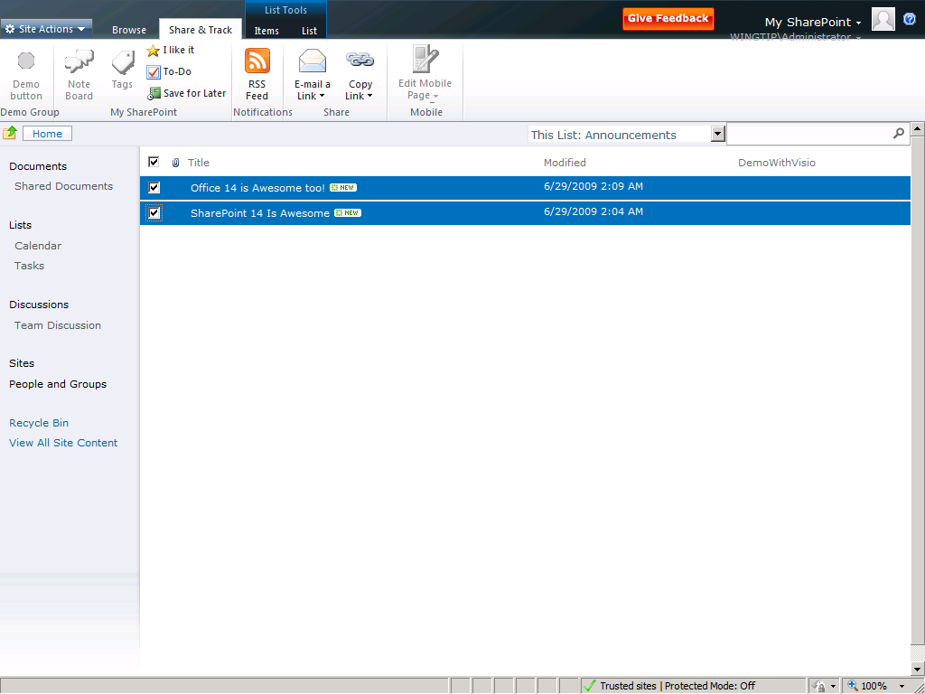
Bulk Operations on List Items
Custom
?
Notes:
An often asked feature is allowing operations on more than one list item at a time. The new SharePoint 2010 view technology allows not only built-in actions to interact with the selected list items. SharePoint 2010 will also allow custom solutions to reach into a list view Web Part to get its selection and refresh it after changes have occurred.

Slide 17
Dialogs
demo

Slide 18
Outline
Introducing the new User Experience
The SharePoint Fluent User Interface
Sites as Collections of Pages
Managing Data with SharePoint 2010

Slide 19
sites are collections of pages
Notes:
This slide introduces the attendees to the concept of using pages instead of lists as the primary concept modeled by SharePoint. Uses think about sites as a collection of pages, and not as a collection of lists. This distinction made it hard for users to customize a SharePoint site to their liking. The default.aspx page on a team site is difficult to edit with lots of navigations and page refreshes.
The goal is to make SharePoint an easier environment for users to customize by makes editing pages very easy.

Slide 20
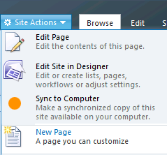
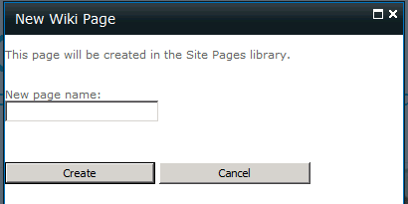
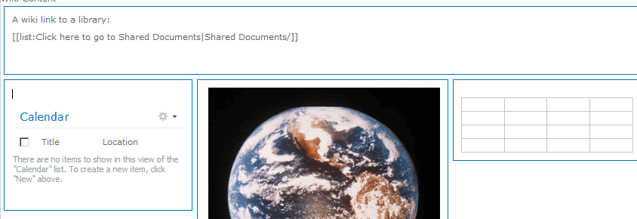
Pages Everywhere
1
Every team site has a pages library
Create a new page with a single click
Just enter a name
Ready to go
[[Wiki Linking]] to
Pages
Lists
Items
Documents
2
3
Notes:
This slide introduces attendees to how SharePoint takes pages as a primary concept. Basically each new Team site has a Wiki Pages library that stores page content. Wikis have a rich interaction model and allow a site to be easily stitched together using groups of pages and Wiki linking. A good demo to show here is to add some new pages to a site and link them together, showing the Intellisense like experience for end-users.
It is very easy to add new Wiki pages to a site. The New Page button is one of the primary buttons in the Site Actions menu. The dialog only asks the absolute minimum of information it needs to create a page, and then the editing experience is kicking in.

Slide 21
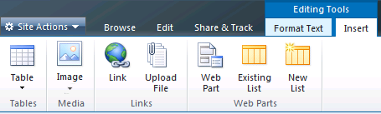
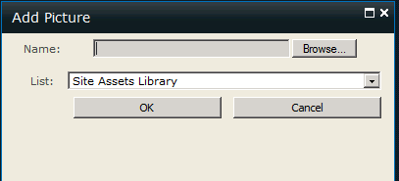

Edit Like in Word
Single click editing experience
Transition to edit is quick and seamless
Type into page and format text like in Word
Full set of rich text controls for formatting and layout
Streamlined insert experience for images, links
Asset library
Edit
Pick Content
Insert
Notes:
Next there is a little bit of focus on how to get rich content into your page. In Word adding an image to a document can be done by a single button and a single dialog. In SharePoint 2007 the number of steps are many times larger. SharePoint 2010 brings back the sanity. You can easily insert rich content, not only images, but tables and Web Parts and Lists too. You can talk about the Site Asset Library taking away the question of where to store an image that needs to be displayed on a page (earlier, people would need to first create a separate library or store the image amongst the pages)

Slide 22
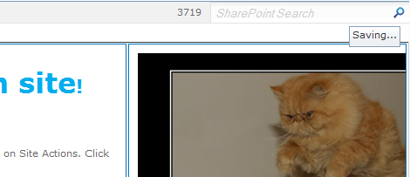
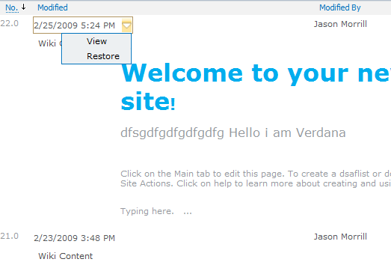
Safe and Simple
Auto-save every minute, no data-loss
Only save if user made changes
Edit\Stop Editing – no prompts
Whoops Protection
Rich Text Editor has undo stack
Versioning turning on, in case you want to revert
Notes:
Editing content on the web is a different experience compared to editing in a rich client. Internet connectivity might fail and the server will have a difficult time finding out if you are still there. SharePoint 2010 offers a few capabilities to ensure that you do not lose your edits.

Slide 23
Master Pages
v4.master
User content pages (lists\content pages\etc)
_layouts pages (site settings, etc)
minimal.master
If you do not need site navigation
If you do not have a ribbon
If your app needs the space
simple.master
Not customizable, but pages can be replaced
default.master
Show site using legacy interface
Team site masterpage
For app experiences, like Search or Office Web Applications
For error pages or login pages
No Ribbon, no fluency
Notes:
Now that pages are the topic of discussion, master pages and a little branding fits in too. SharePoint 2010 ships with a number of master pages. Important topics to discuss on this slide is how application pages can now also make use of branded master pages, and how there is a default.master that ships the (non-fluent) v3 UI for backwards compatibility.

Slide 24
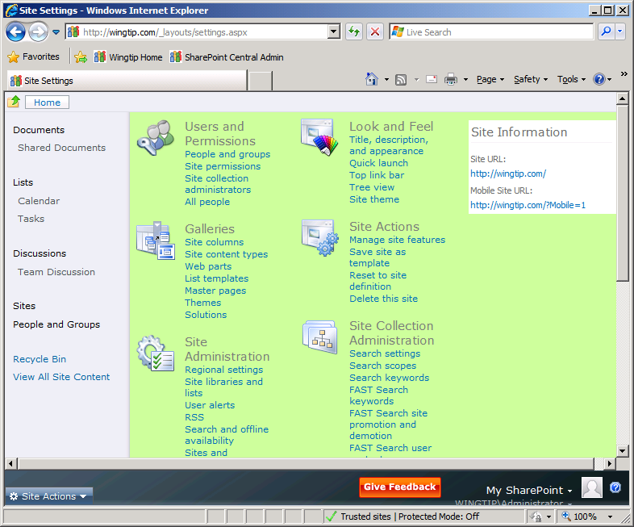
Branded Application Pages
Notes:
Just an image to show this capability. What you see is a Ribbon placed at the bottom of the page, instead of at the top of the page. Something that is not easily achieved using just CSS styles.

Slide 25
Multi-Lingual Interface
Display one site in multiple languages
Language Pack based
End-user translations
Primary language set during provisioning
Secondary language set by end-user
OM Support
PLACE HOLDER FOR IMAGE OF ADMIN UX
Notes:
An important feature when it comes to languages in SharePoint is the new support for multi-lingual sites. Formerly each site was provisioned using a single specific language which could not be changed. This language determined the look of a large number of UI elements such as labels. SharePoint 2010 allows you to associate more than one language with a site so that end-users can browse the site in a language of their choice. There are obvious limitations to this ability, such as list data.

Slide 26
Standards Compliancy
Well-Formed XHTML 1.0
Cross-Browser
Tier 1 support: IE, Firefox
Tier 2 support: Safari
WCAG 2.0 AA
New Rich Text Editor supporting XHTML.
Notes:
SharePoint makes use of the XHTML standard for displaying content. Earlier versions of SharePoint either didn’t indicate what to use, or made use of the very much legacy HTML 4.01. This was not an issue for users of Internet Explorer, however, for support in other browsers this wreaked havoc. Even with custom development it is hard to make SharePoint 2007 spit out sane HTML. This will not be the case for SharePoint 2010 where XHTML is the standard that is followed.
There are now two tiers of browsers supported, each tier contains a specific set of browsers. Tier 1 consists mainly of 32-bit Internet Explorer 7 and 8 or FireFox 3. Tier 2 contains 64-bit Internet Explorer, FireFox on non-windows OS and Safari.
Notice that Internet Explorer 6.0 is no longer a supported browser.

Slide 27
Light Up with User Custom Action
Add commands to common locations
ECB
Ribbon
Form Toolbars
View Toolbars
Settings pages
Scoped to list / site / site-collection
SharePoint Designer / Object Model support
Declarative, no User / Custom Controls
Notes:
Now that more than one form can be displayed through SharePoint designer, there is an equally strong desire to provide UI that links to these forms. The User Custom Action capability of SharePoint 2010 allows end-users to customize the user interface without the need to involve IT. This includes adding content to the ribbon.
One of the key aspects of what end-users cannot do, is making use of code in the form of user and custom controls. The reasons for not allowing this are obvious; security and stability.
Adding custom actions to Form Toolbars and View Toolbars. Toolbars will be disabled by default in the V4 UI and any custom actions will show up in the Custom Commands section of the ribbon. If the custom actions use a code behind they don't show up at all unless you enable to tool bars using the ListViewWebPart.

Slide 28
User Actions
demo

Slide 29
Outline
Introducing the new User Experience
The SharePoint Fluent User Interface
Sites as Collections of Pages
Managing Data with SharePoint 2010

Slide 30








Customer Asks Related to Forms
I want more types than just new, edit and view forms.
I want to change the Web Part in my forms.
I want to be able to create richer forms more easily.
Notes:
Now that the attendees have seen the new fluent UI and the concept of pages as prime content, it is time to discuss what happened to lists, which was the primary concept of SharePoint 2007.
There are of course many great things about SharePoint 2007 list support. The notion of being able to author rich data without involving IT is very powerful. However, some limitations in the product made it difficult if not impossible for end-users to achieve certain goals. Validation is one area that was not well though out. You could not validate a textbox, or change the background color on required fields, at least, not without involving developers.

Slide 31
SharePoint 2010 Form Support
Multiple forms per type
User Actions for navigation
New Web 2.0 view technology
Replace default view / edit Web Part
InfoPath integration
Notes:
This slide introduces some of the new capabilities of SharePoint 2010, with a focus on what is new for the UI. Later slides go in more detail for each of these bullets.
There are more new list capabilities that are available in SharePoint, such as out-of-the-box validation using formulas. These can be mentioned but will not be discussed until the next module.

Slide 32
Multiple Form Support
Create an arbitrary number of forms for
Display
New
Edit
Set default forms to show
Notes:
SharePoint 2010 allows you to create a variety of display, new and edit forms. Technically each form still falls into one of these categories, you can just have more than one of each category, so you cannot create a BulkEdit form type. You can make use of SharePoint designer capabilities to author these forms, and as a developer you can integrate this into the list templates and content-types that are developed.

Slide 33
XsltListViewWebPart
Replaces ListViewWebPart
Web 2.0 View Framework
Schema agnostic
Better UX
In-Place Editing
BaseXsltData WebPart
DataForm WebPart (V3)
BaseXsltList WebPart (v4)
DataView WebPart (V2)
XsltListForm WebPart (V4)
XsltListView WebPart (V4)
WebPart
ListForm WebPart
ListView WebPart
Notes:
SharePoint has two types of viewing demands. Viewing interactive forms for editing list items, and viewing lists of items. For each of these demands there have been a variety of technologies that have seen the light of day. SharePoint 2003 introduced basic interaction through the ListForm and ListView. SharePoint 2007 has the DataFormWebPart (commonly referred to as Data-View). All of these technologies will be made redundant with the coming of SharePoint 2010.
The new view technology to discuss is the XsltListViewWebPart. It provides benefits across the board. By making use and building upon the rich features of the Data-View but making it more generic SharePoint 2010 has a higher ability for re-use and lowers the bar for custom development.

Slide 34
Comparing View Technologies
 | List View | List Form | Data Form | XSLT List View
Rendering Technology | CAML | ASP.NET | XSLT | XSLT
Render Lists | X |  | X | X
Render Items |  | X | X | X
Aggregate Data |  |  | X | X
Render External Data |  |  | X | X
Browser Editing | X | X |  | X
SPD Editing |  |  | X | X
Parameterizable |  |  | X | X
Conditional Formatting, High customizability |  |  | X | X
Performance | X | X |  | X
Notes:
This slide discusses some of the differences between the prevailing view technologies in SharePoint. Especially the difference in technology used to render content (CAML / ASP.NET or XSLT) is a big difference between these Web Parts.

Slide 35
Inside the XsltListViewWebPart
XmlDefinition
CAML Query
SPDataSource
XML Data
XsltListView WebPart
ListName
List Schema
HTML
XslCompiled Transform
XSL
View Transform
Notes:
The XsltListViewWebPart generally takes the same approach as a normal data view. However, since the XSLT is now schema-agnostic, you need to pass in the schema as a separate parameter and no longer pass this information as content of the view.

Slide 36
InfoPath 2010 and SharePoint 2010
Improved Field Picker
List Data Connection
Library Data Connection
List Forms
Notes:
One important platform for authoring forms is InfoPath. Earlier versions of InfoPath did not have a high enough level of integration with SharePoint to allow InfoPath to be the tool to create rich interactive forms. New features in InfoPath 2010 do allow InfoPath to play this role. There are many awesome scenarios that are now enabled for information workers, without the need to involve IT. Simple tasks such as validating a field, creating regions or setting colors can now be easily done inside the InfoPath productivity UI.

Slide 37
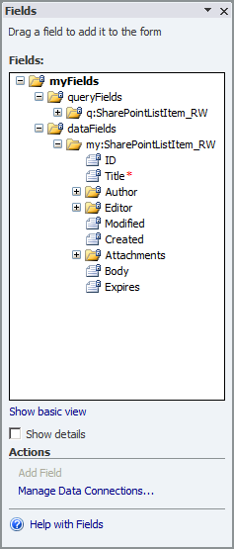
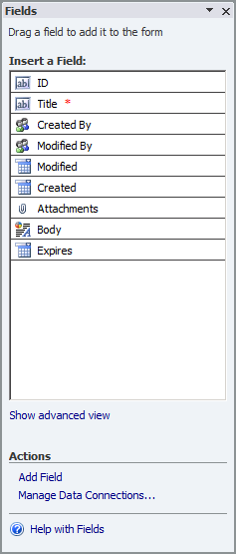
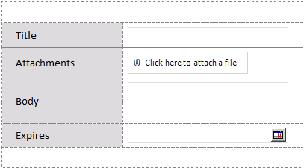
Creating an InfoPath List Form
Notes:
Work has been done in the InfoPath team to ensure that Information Workers get the experience they expect when editing forms using InfoPath. The InfoPath data source is hidden behind a ‘advanced view’ to hide the hierarchical nature of InfoPath data. The controls that you can use in InfoPath now also have parity with SharePoint.

Slide 38
XsltListViewWebPart
demo

Slide 39
Summary
Introducing the new User Experience
The SharePoint Fluent User Interface
Sites as Collections of Pages
Managing Data with SharePoint 2010

